Slide 1
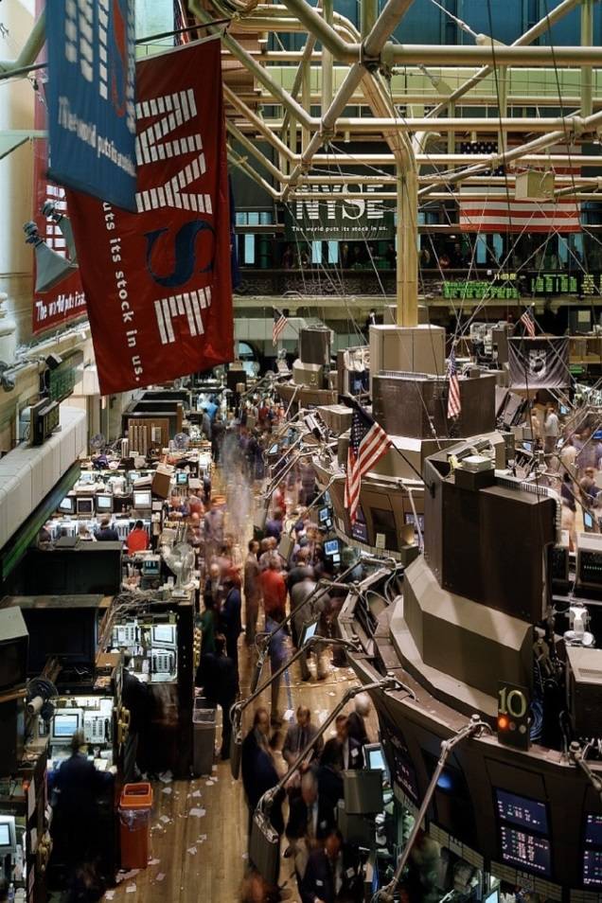
- Chapter
2 —
The
Dot.com bubble

Slide 2
The Internet arrives
In the early 1990s, the Internet and the World Wide Web were still in their infancy.
The use of the internet for commercial use – still less as the global shopping center that it would become - was still in the future.
Slowly, however corporate America was realizing that through the internet it could reach millions of customers, most of them affluent and educated.
The idea that the Internet might come to dominate how commerce was conducted, was beginning to take hold.
///

Slide 3
Wall Street catches on
With demand for Internet-related companies beginning to catch the imagination of investors, Wall Street investment banks had been sensing their own opportunity.
Managing an initial public offering (IPO) is a lucrative business for the investment bank that manages and guides the new company through the process of becoming a company listed on the stock exchange.

Slide 4
Netscape
In 1995, Netscape was a company that was a little more than a year old and losing money.
Nevertheless, Netscape’s browser looked like it might successfully challenge Microsoft’s version.
The investment bank Morgan Stanley agreed to manage the company Netscape to an IPO. On its first day, the company was worth over three billion dollars.
Pretty much everyone involved in the company was seriously rich, and its founder Jim Clark was – quite instantly - one of the richest men in the US.

Slide 5
An Internet bubble
The upsurge in the stock market was now catching the imagination of the American public.
As more middle-class Americana entered the market, it was beginning to fuel its own rise.
Between the beginning of 1995 and the end of May 1996, the Dow climbed 45%, the Nasdaq by 65%, with stocks like America online, Netscape and Yahoo! riding high.
At the start of 1996, the markets were rising again.

Slide 6
A word on Funds Management
At the end of every quarter, fund managers are assessed relative to their peers in a series of published league tables.
In this environment, following the herd can be the optimal strategy.
If stock prices continue to rise during a given quarter, the fund manager who keeps all his money in the markets will look clever.
Even if the market crashes, the fund manager is reassured by the fact that most of his competitors have suffered the same fate ("everyone takes a bath together”).
Only by stepping out of line, does the fund manager jeopardize his career.

Slide 7
Self-fuelling prices
Trapped in this logic, the vast majority of fund managers were now buying stocks regardless of their prices.
In effect, many mutual fund managers were continuing to buy stocks even though they believed them to be overvalued, which caused the market to become even more overvalued.

Slide 8
Jeffrey Vinik resigns
For the skeptics, the stock valuations were inexplicable.
Jeffrey Vinik, the manager of the biggest mutual fund in the US, Fidelety’s Magellan Fund, decided to withdraw the fund’s money from the market only to see the fund’s performance suffer in comparison to rival funds.
Jeffrey Vinik found himself resigning, which generated the comment,
“He was early, and there’s no difference between being early and being wrong”.

Slide 9
The Internet and stock market growth
In September 1996, Greenspan kept interest rates on hold, Bill Clinton was re-elected in a landslide, and the Dow had raced to 6,500 – it had almost doubled in two years.
Online commerce was shaping up to be one of the biggest industries of the twenty-first century, and American companies dominated it. Bill Clinton quipped, “When I took office, only high energy physicists had ever heard of what is called the World Wide Web. Now even my cat has its own page”.

Slide 10
The party
Alan Greenspan had resisted pressure from his colleagues at the Fed to raise interest rates by more than a quarter of a percent. In July, the Dow jumped close to 8,000 for the first time.
The popular media was also doing its best to keep the party going. On all but the darkest days, an upbeat tone was maintained for the American public with enthusiastic and perky reporting, mostly by analysts and fund managers who had a strong incentive to talk up the market. Stock prices were soaring, and more and more Internet companies were going public.

Slide 11
The Greenspan touch
In just twelve months, Amazon.com’s stock had risen almost tenfold, and America Online and Yahoo! had risen almost six fold. The British publication The Economist announced that “The Fed needs to raise interest rates now”; and the British newspaper, The Financial Times stated, “This is unquestionably a bubble”, but was rebutted by The New York Times: the advice from the UK press, it would appear, was unwelcomed. Yahoo!’s stock had now made paper billionaires out of its founders Jerry Yang and David Filo.
When prices started to gyrate wildly in late 1998, Greenspan again cut interest rates. When Greenspan cut rates again, the chief economist at Goldman Sach’s commented, “This is a way of telling everyone, the lifeguard is back on duty; you can get back in the pool.”
Greenspan’s apparent ability to sustain the markets with a lowering of interest rates was now referred to as the “Greenspan touch”.

Slide 12
Internet Mania
The epic stage of the Internet bubble lasted from October 1998 to April 2000.
During that period, more than 300 Internet firms came to the market as IPOs.
A position of refusing to buy Internet stocks on the grounds that they were over-hyped, had become a costly and embarrassing mistake. The clever people were those who had purchased Excite, Yahoo! and Amazon.com some time back and were now boasting of their Internet wealth.
Ten million shares of Priceline.com opened on the Nasdaq at $16, and the price immediately jumped to $85, before settling back to $68 at market close of trading for the day. Priceine.com was therefore valued in the markets at almost $10 billion, more valuable than United Airlines, Continental Airlines, and Northwest Airlines combined (whose tickets it was merely helping to sell).

Slide 13
Internet Mania (cont)
It was getting difficult to keep track of all the Internet IPOs.
The speculative bubble had now spread beyond Internet stocks to encompass the
entire technology sector.
On Friday, December 31, 1999, Muhammad Ali rang the opening bell on the New York Stock Exchange. When the closing bell rang, the Dow was at an all-time high of close to 11,500. For the year, it was up 25 percent. The Nasdaq, which the previous day had closed above 4,000 for the first time was up 86 percent on the year.
The Dow Jones Internet Composite Index had climbed 167 percent on the year.

Slide 14
The markets and the real economy
Greenspan was resisting pressure to tighten monetary policy.
The real economy and the financial economy were now intertwined as people’s sense of increased stock market wealth fuelled an unprecedented spending spree on the part of consumers and firms, which, in turn, stimulated economic growth.
In both 1998 and 1999, the economy continued to expand at some 5 percent, and in early 2000, it appeared that the expansion might even be accelerating.
On January 14, 2000, the Dow almost tipped 12,000. Although nobody knew it at the time, the index had peaked. Nevertheless, the Nasdaq continued to climb. On March 7, moving from 3,000 to 5,000 had taken just four months. The Dow Jones Internet Composite Index had risen by 130 percent in twelve months.

Slide 15
Heady times
Nevertheless, the Nasdaq began to suffer increasing mood swings. There wasn’t any particularly bad news, but in the early months of 2000, a sense of uncertainty was gaining.
On Monday, April 3, for example the Nasdaq lost 7.6 percent in one day, and then staged a comeback for the rest of the week, leaping 4 percent on the Friday of that week.

Slide 16
Reversal
On the Monday of April 10, 2000, selling continued.
The same self-reinforcing process that had propelled stock prices in the upward direction was now operating in reverse, sending stocks hurtling down to earth. And the same technology that had allowed investors - big and small – to buy at the touch of a button, now allowed then to sell just as easily. The falling market was simply feeding on itself, just as the rising market had fed on itself. April 14, 2000 was “Black Friday”.
Since peaking on March 10, the Nasdaq had dropped 34 percent, and the Dow Jones Internet Composite Index had dropped 54 percent from its height on March 9. The Internet bubble had well and truly burst.
The Nasdaq climbed back above 4,000 during the summer before entering its death throes in a steep decline that would last to the end of the year.
At the commencement of 2001, George Bush became president of the US. Microsoft was now down 63 percent on the year, Priceline.com was down 97 percent, Yahoo! 86 percent, and Amazon.com, 77 percent. On March 9, 2001, which was the first anniversary of the Nasdaq closing above 5,000, the index ended the day barely above 2,000. Through the summer of 2001, the declines continued.

Slide 17
Meltdown
The psychological blow to America’s sense of a shining new world coupled with a sense of its superiority suffered a further blow with the terrorist attacks of September 11, 2001 on the World Trade Center and the Pentagon.
Later in the month, the Dow fell back below 8,000 and the Nasdaq dropped below 1,200.
In all, more than $7 trillion of wealth (at prices of the day) had been wiped out since the Nasdaq peak in March 2000: about $70,000 for each household in the country.
///

Slide 18
Realization
The realization now was that the Internet, for all its transforming of information communication, was not actually about to change very much else. It had been hyped, and was not, as was once supposed, an all-encompassing phenomenon that had the capacity to restructure the Old Economy.
People would continue to prefer to buy most goods in a store, where they can look at them, pick them up, and try them out.
In short, people would continue with most activities, from drilling holes and attaching wings to airplanes, to operating on patients and serving businessmen lunches, and getting from A to B, pretty much as before.

Slide 19
Recovery
After September 11, the economy actually recovered surprisingly quickly.
One reason was the increase in government spending, particularly on military spending.
More importantly, the Fed had moved swiftly to further reduce the cost of borrowing. From a peak of 6.5 percent in 2000, the Fed had cut the federal funds rate to 1.25 percent in November 2002.
On June 24, 2003, Greenspan reduced the rate to 1.0 percent. From there, rates did move up cautiously, while remaining below 2.5 percent until November 2005.
//////

Slide 20
The housing market
The cheap borrowing rate provided a boost to the housing market. As mortgage rates hit historic lows, many Americans who had suffered in the stock market crash, at least found that the value of their homes was rising to offset their losses.

Slide 21
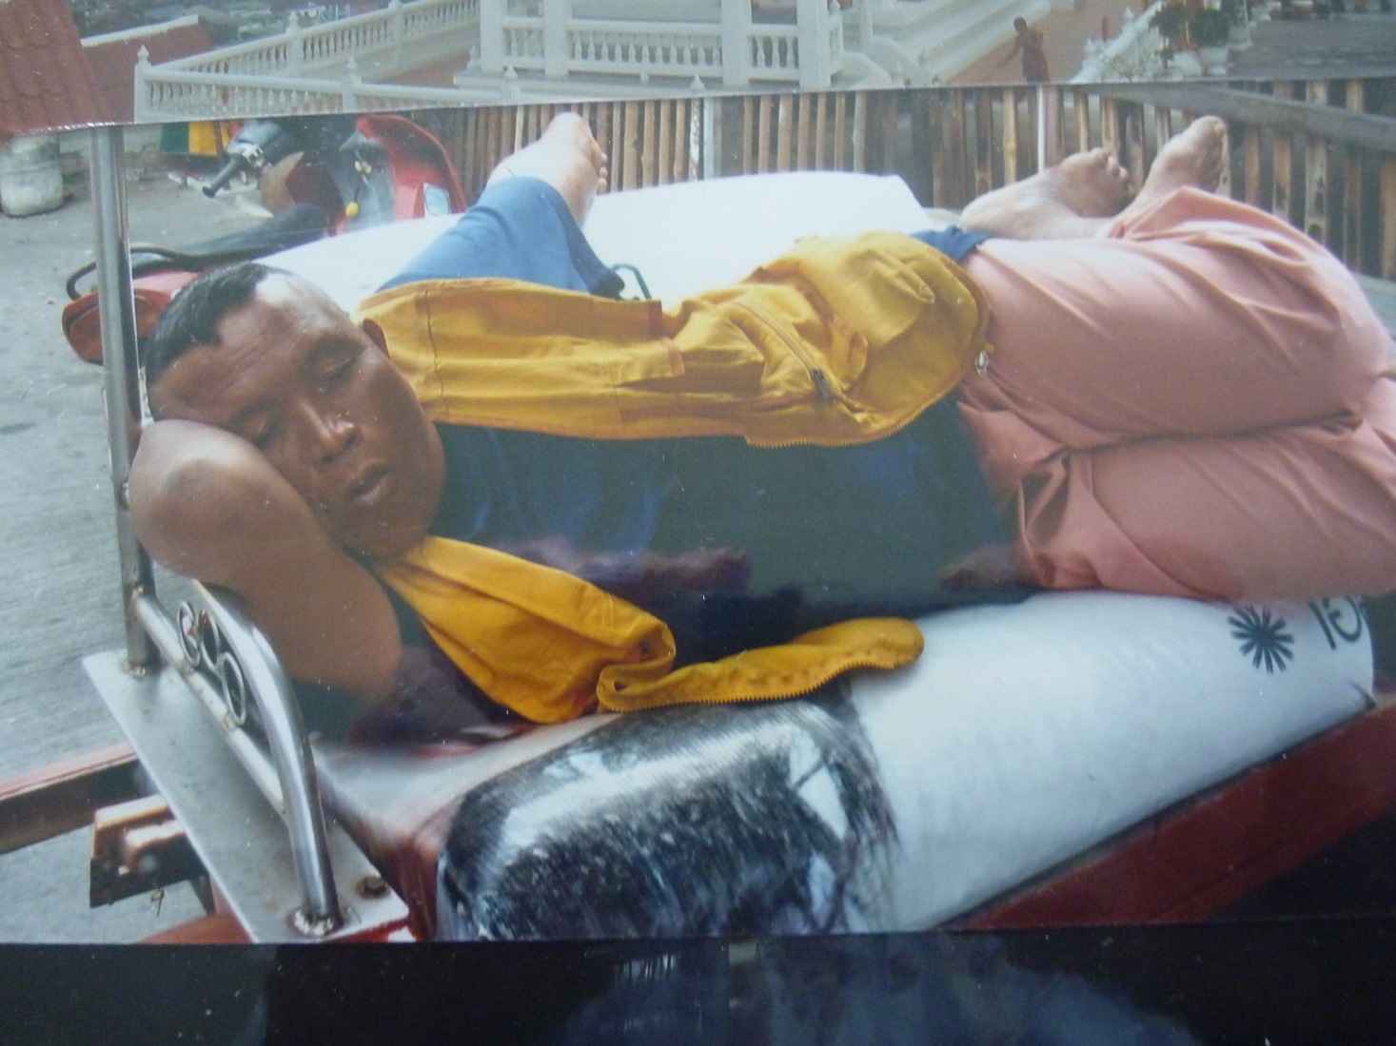
Break time

