Slide 1

- CHAPTER 13 -
Equity Valuation
And Personal Taxes

Slide 2
Equity valuation and personal taxes
We consider the implications of personal taxes on dividends and capital gains, and progress to describe an imputation tax system.

Slide 3

The discounting of dividends model revisited
A difficulty with the discounting of dividends model (Eqn 5.6):
$P_{0}^{cum}=\${DIV}_{0}+\frac{{\$DIV}_{1}}{(1+k)}+\frac{{\$DIV}_{2}}{{\left(1+k\right)}^{2}}+\frac{{\$DIV}_{3}}{{\left(1+k\right)}^{3}}+ . . . +\frac{{\$DIV}_{N}}{{\left(1+k\right)}^{N}}$ (5.6)
is that it assumes that $1 of dividends equates with $1 of markets value. Consider, for example, a firm that terminates with a closing dividend: $P_{0}^{cum}=\${DIV}_{0}$

Slide 4

A new discounting of dividends model
In effect, we require that Eqn 5.6 should be replaced by
$P_{0}^{ex}=\${DIV}_{0}x q+\frac{{\$DIV}_{1}x q}{(1+k)}+\frac{{\$DIV}_{2}x q}{{\left(1+k\right)}^{2}}+\frac{{\$DIV}_{3}x q}{{\left(1+k\right)}^{3}}+ . . . +\frac{{\$DIV}_{N}x q}{{\left(1+k\right)}^{N}}$ (13.3)
where q is the market value of a $1 dividend

Slide 5
The market value of a $1 dividend?
Imagine that a share has a market value of $P₀
and is about to pay a dividend, $DIV.
Suppose that you are an investor about to purchase the share, cum-dividend so as to receive the dividend, $DIV, at a market price of $P^{cum}.
Alternatively, you might choose to purchase the share ex-dividend at what you anticipate will be a lower cost, say, $P^{ex} (since you forego the dividend).
What is the rational price, $P^{ex}, at which you are prepared to purchase the share ex-dividend in relation to the current cum-dividend market price, $ P^{cum}?

Slide 6

The market value of a $1 dividend (cont)
You could argue that purchasing the share cum-dividend provides an additional $DIV (1- t_{d}) in your pocket plus an additional $(P^{cum} - P^{ex})t_{g} of capital gains tax relief when you come to sell the share.
In this case, you would determine the ex-dividend share price you are prepared to pay ($P^{ex}) in relation to the current cum-dividend share price ($P^{cum}) by equating the difference in prices - $(P^{cum} - P^{ex}) - with the difference in benefits:
P^{cum} - P^{ex} = $DIV (1- t_{d}) + $(P^{cum} - P^{ex})t_{g}
which (with a little manipulation) provides the theoretical change in share price when the firm makes a dividend, $DIV:
P^{cum} - P^{ex} = $$DIV\frac{1− t_{d}}{1− t_{g}}$ (13.2)

Slide 7

The market value of a $1 dividend (cont)
Given P^{cum} - P^{ex} = $$DIV\frac{1− t_{d}}{1− t_{g}}$ (previous slide) (13.2)
we therefore deduce, in a world where investors can be represented as subjective to a personal tax on dividends = t_{d}, and on capital gains = t_{g},
that the market value of a $1 dividend (which we shall call q), is determined as:
q = $\frac{1− t_{d}}{1− t_{g}}$ (13.4)

Slide 8

Dimensional Consistency
We note that our new Eqn 13.3:
$P_{0}^{cum}=\${DIV}_{0}x q+\frac{{\$DIV}_{1}x q}{(1+k)}+\frac{{\$DIV}_{2}x q}{{\left(1+k\right)}^{2}}+\frac{{\$DIV}_{3}x q}{{\left(1+k\right)}^{3}}+ . . . +\frac{{\$DIV}_{N}x q}{{\left(1+k\right)}^{N}}$
accords with the principle of dimensional consistency, in that $DIV_{i} x q represents the market valuation of the dividend,
so that we determine a market value ($P₀) by discounting the market value of dividends ($DIV_{i} x q) by a discount factor (k) that represents investor’s market capital growth rate.

Slide 9

The cost of equity redefined
In Eqn 13.3, we have k as
$k= \frac{{DIV}_{1}.q + P_{1}^{ex}−P_{0}^{ex}}{P_{0}^{ex}}$ (13.5)
which identifies k as investors’ required capital growth rate for the firm inclusive of the firm’s cash distributions.
Equation 13.5 may be refigured as:
k = d.q + g (13.6)
where d represents shareholders’ expectation for the firm’s dividend yield - $\frac{{DIV}_{1}}{P_{0}^{ex}} −$ and
g represents shareholders’ expectation for the firm’s capital growth rate (net of the firm’s dividend payments)
- ie $\frac{ P_{1}^{ex}−P_{0}^{ex}}{P_{0}^{ex}}$ - with q identifying the market value of $1 of the firm’s distributions as dividends.

Slide 10
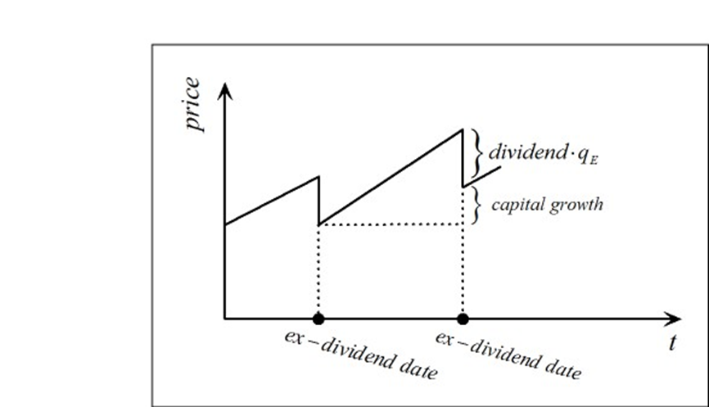
The components of a stock’s capital appreciation

Slide 11

An example
Suppose that you are applying Eqn 5.8:
${P_{0}^{ex}=share value}_{0}^{ex}=\frac{\${DIV}_{1}}{k−g}$
to the valuation of a share in Company Fats that has maintained a steady growth rate of 2.0% over a number of years.
The share has recently paid a dividend and is trading at $20.0.
Consistent with the firm’s reliable growth rate in dividends over the years, you anticipate a dividend of $1.60 one year from now.
You also believe that the firm can maintain a growth rate of 4.0% going forward.
Accordingly, with Eqn 5.8, you determine shareholders’ required return in the above firm (k) as
k = $\frac{\${DIV}_{1}}{P_{0}^{ex}}$ + g = $\frac{\$1.60}{\$20.0}$ + 0.04 = 0.08+0.04 = 12.0%.

Slide 12

An example (cont)
Now suppose that you are seeking to value a share in Company Domino, which, you believe, has similar characteristics and hence a similar cost of equity to Fats.
This share has an anticipated dividend one year from now = $10.0 and also appears likely to maintain a growth rate of 2.0% going forward.
Accordingly, you estimate the fair price of Domino as
$P_{0}^{ex}=\frac{\${DIV}_{1}}{k−g}$ $=\frac{\$10.0}{0.12−0.02}$ = $100.

Slide 13
An example (cont)
Required
Re-evaluate your above calculation is the light of your consideration of personal taxes.

Slide 14

An example (cont) Solution
Eqn 5.6 becomes
${P_{0}^{ex}=share value}_{0}^{ex}=\frac{\${DIV}_{1}x q}{k−g}$
Hence we have:
k = $\frac{\${DIV}_{1}xq}{P_{0}^{ex}}$ + g = $\frac{\$1.60x0.8}{\$20.0}$ + 0.04 = 0.064+0.04 = 10.4%.
For Domino, we now determine
$P_{0}^{ex}=\frac{\${DIV}_{1}x q}{k−g}$ $=\frac{\$10.0x0.8}{0.104−0.02}$ = $95.2
(5% less than when we ignore personal tax effects)

Slide 15

Break time

Slide 16
Personal taxes and an imputation tax system
An imputation tax system recognizes that when the firm pays a dividend from the firm’s after-corporate tax earnings to shareholders, the firm’s shareholders - as owners of the firm - have already paid corporate tax on the firm’s earnings.
Thus, an imputation tax system allows that corporate tax (at rate T_{c}) paid by the firm may be imputed (attributed) as a pre-payment of the firm’s shareholders personal tax liability on dividends received.

Slide 17
Personal taxes and an imputation tax system (cont)
The logic that is applied is that - with a corporate tax rate (T_{c}) of, say, 30% - when a shareholder receives a 70 cents dividend, the 70 cents represents $1.0 of earnings that the firm earned prior to corporate tax
(since $1.0 of earnings before corporate tax equates with $1.0 x 0.7 = 70 cents after corporate tax).

Slide 18
Personal taxes and an imputation tax system (cont)
An imputation tax system therefore allows that on receiving a 70 cents dividend, a shareholder with a personal marginal tax liability (t_{p}) on income of, say, 40%, should be allowed to retain 60% - not of the 70 cents received – but of the $1.0 of firm earnings prior to corporate tax that allowed the 70 cents to be paid as a dividend.

Slide 19

Personal taxes and an imputation tax system (cont)
In other words, on receiving a dividend $DIV, the above shareholder is allowed to retain 60% of the earnings that funded the dividend payout prior to corporate tax; which is to say, the shareholder is allowed to retain:
After tax dividend = $\frac{\$DIV}{\left(1−T_{c}\right)}\left(1−t_{p}\right)$ (13.7)

Slide 20

Personal taxes and an imputation tax system (cont)
Suppose we identify the shareholder’s effective tax liability on the $DIV received as t_{eff} – meaning that by definition of t_{eff} , the shareholder gets to keep $DIV (1- t_{eff}) .
We therefore can write:
$\frac{\$DIV}{\left(1−T_{c}\right)}\left(1−t_{p}\right)=\$DIV(1−t_{eff})$,
yielding:
$t_{eff}=1−\frac{1−t_{p}}{1−T_{c}}$ (13.8)

Slide 21
Personal taxes and an imputation tax system (cont)
Suppose that the corporate tax rate is 30% in Australia, against which you receive a fully-franked dividend of $1.16.
Assume that your personal marginal tax rate on income received is 40%.
Calculate the proportion of the $1.16 dividend that you are able to maintain after fulfilling your personal tax obligations. Calculate your effective tax rate on the $1.16 dividend received.

Slide 22

Personal taxes and an imputation tax system (cont)
You “get to keep” :
$\frac{\$1.16(1−0.4)}{(1−0.3)}$ = $0.994 (99.4 cents).
With Eqn 13.8, your effective tax rate is determined as
$t_{eff}=1−\frac{1−t_{p}}{1−T_{c}}$ = 1 - $\frac{0.6}{0.7}$ = 14.3%.
( Check: $\frac{tax paid}{dividend received}$= $\frac{\$(1.16 −0.994)}{\$1.16}$ = 14.3% )

Slide 23
Review
We have observed that the discounting of dividends model of Chapter 5 is strictly invalidated if we allow for personal taxes.
In addition, we have assessed the theoretical implications of personal taxes under an “imputation” tax system.

Slide 24


