Slide 1
—Chapter 7—
Accounting Statements and Ratio Analysis

Slide 2
Legal requirement for the firm’s financial reporting
A publically incorporated company is legally obliged to issue accounts of its financial position for public scrutiny (in addition to an annual report, the firm may choose to provide semi-annual or even quarterly reports).
The reports should conform to the accepted standards of Accounting reporting and be reviewed – “audited” - by an independent auditing firm, which signs off on the reports as providing a true and correct representation of the company’s financial position.
As such, the reports are expected to highlight the financial health of the company to investors, who are thereby provided with a measure of protection on their investments.

Slide 3
The Income Statement
The firm’s annual Income Statement is designed to provide a meaningful summary of the firm’s performance over the previous financial year.
To this end, the statement commences with the receipts from the firm’s Sales and thereafter deducts various “costs” so as to arrive at the amount that ultimately remains either
(i) to be distributed to shareholders as
dividends ,
or (ii) to be retained by the firm as
Retained earnings
under Shareholders’ Equity in the Balance Sheet.

Slide 4
Components of the Income Statement: Net Sales
Thus, the statement commences with the firm’s
Net Sales,
which is to say, the firm’s income receipts that are an outcome of the goods and services that the firm provided for its customers or clients over the reporting period of the accounts. The firm’s “costs of production” are subtracted from Net Sales so as to achieve a measure of
“profit”.

Slide 5
Components of the Income Statement (cont): Variable operating costs
Variable operating costs are the costs that are a direct function of the product items or services produced – which is to say, the costs that can be attributed to each additional item of production or service produced. Thus, the greater the number of items or services that the firm provides, the greater should be the firm’s Variable operating costs. When we subtract the
Variable operating costs
that it took to produce the firm’s Net sales, we have
the firm’s Gross Profit.

Slide 6
Components of the Income Statement (cont): Fixed operating costs
In addition, to the Variable operating costs of sale, we allow for the annual ongoing costs of maintaining the firm; which is to say, the costs that are independent of the actual number of goods or amount of services produced.
We have in mind such as the maintenance of machines, the wages of the firm’s employees, the rental of office space, heating costs, and insurance premiums, that must be paid for even if the firm produced no goods or services in that year.
These are the firm’s Fixed operating costs.
When we subtract the Variable operating costs and Fixed operating costs from the firm’s Net Sales, we arrive at the firm’s
Earnings before interest, taxes,
depreciation and amortization (EBITDA).

Slide 7
Components of the Income Statement (cont): Depreciation and Amortization
Depreciation and amortization recognize that the firm’s profits could not be acquired without some deterioration in value of the firm’s assets. No actual expenditure is necessarily involved at this stage, but it makes sense, nevertheless, to recognise the deterioration of the firm’s assets over the year as a “cost” to be deducted from the firm’s earnings.
The Depreciation and Amortization entered in the Income Statement is the amount that the tax authorities allow against the firm’s tax liabilities in that year.
When we subtract the firm’s Variable operating costs, Fixed operating costs, and Depreciation and Amortization from the initial Net Sales entry, we arrive at the firm’s
Net operating income (NOI),
which we also refer to as the firm’s
Earnings before interest and tax (EBIT) for the year.

Slide 8
Components of the Income Statement (cont): Interest payments and tax
The firm must make due payments to its
(1) bond (debt) holders and
(2) the tax authorities.
The order of the payments is important.
The firm’s annual interest payments on its debt are first subtracted from the EBIT to arrive at the firm’s Earnings before tax (EBT) that is subject to corporate tax.
Thus, we observe that the tax authorities allow the firm to deduct its Interest payments as a cost from the firm’s EBIT before imposing tax at the prevailing corporate tax rate on the remaining Earnings before tax (EBT).

Slide 9
Components of the Income Statement (cont): Net Income
The deduction of the firm’s Tax obligations on its EBT finally determines
the firm’s Net Income.
The firm’s Net Income represents the “bottom line” residual that is available to the firm’s shareholders.
The firm will then choose the amount of Net Income to distribute as a dividend, and the remaining amount that will be maintained by the firm as an
Addition to retained earnings
in the Balance Sheet

Slide 10
The Balance Sheet
The Balance Sheet depicts the firm’s ASSETS (left-hand side of the Balance Sheet) as they have been funded either
(i) by issuing debt, or
(ii) as contributed by the firm’s shareholders.
The firm’s bond holders and shareholders – which the firm is called on to satisfy financially - are together envisaged as the firm’s
LIABILITIES AND EQUITY
on the right-hand-side of the Balance Sheet.

Slide 11
The Balance Sheet (cont)
An addition to the firm’s ASSETS on the left-hand side of the Balance Sheet is always matched by the source of financing on the LIABILITIES AND EQUITY side of the Balance Sheet.
Sources of finance might be:
(i) by additional debt (either short term borrowing or by a longer term issue of bonds) or
(ii) by the firm’s Retained Earnings accumulated from the firm’s operations year by year,
or by current shareholders who contribute to a rights issue,
or by having new shareholders who purchase the firm’s new issue of shares.
The additional cash raised by either debt or equity thereby leads to an entry on the LIABILITIES AND EQUITY (right-hand) side of the Balance Sheet and an equal amount on the (left-hand) ASSETS side under Cash and equivalents.
The cash is transferred from Cash and equivalents as assets are acquired, the value of which again appears on the ASSETS side so as to maintain the balance of the Balance Sheet.

Slide 12
Depreciation
The issue of Depreciation deserves a special attention.
At the end of the financial year, we add the Addition to retained earnings (from the Income Statement) to Retained earnings (which thereby contributes to Shareholders Equity) on the (right-hand side) LIABILITIES AND EQUITY side of the Balance Sheet.
We also add both the Addition to retained earnings and Depreciation from the Income Statement for that year to the Cash and equivalents entry on the (left-hand side) ASSETS side of the Balance Sheet.
But note also that on the ASSETS side of the Balance Sheet, the values of the firm’s assets under Net plant and equipment are correspondingly depreciated by Depreciation to recognise their deterioration and limited working life.
Putting the two together – adding Addition to retained earnings plus Depreciation to Cash and equivalents, while deducting Depreciation from Net plant and equipment - we are effectively adding the item Addition to retained earnings on the ASSETS side, which then balances with the Addition to retained earnings to Retained earnings on the LIABILITIES AND EQUITY side of the Balance Sheet.

Slide 13
The Self-locking nature of the Income Statement & Balance Sheet
We summarize as follows:
(1) the entry for Cash and equivalents (first entry in the left-hand side of the Balance Sheet) benefits from the firm’s Addition to retained earnings plus Depreciation (both as recorded in the Income Statement for the current period).
(2) the entry for Net plant and equipment (left-hand side) is determined as the entry for the previous year minus Depreciation as recorded in the Income Statement plus whatever actual expenditure was made for Net plant and equipment in the period;
(3) the entry for Retained Earnings in the (right-hand side) of the Balance Sheet is determined as the entry for the previous year plus the Addition to retained earnings;
(4) all additional sources of funding on the right-hand-side of the Balance Sheet are matched by an allocation of those funds on the left-hand side of the Balance Sheet.

Slide 14
Illustrative Example 7.1: Retained earnings and Depreciation in the Balance Sheet
Suppose a firm retains $2.0 million at the end of an accounting year (as denoted in the Income Statement for this period). Also, suppose that assets are depreciated by $4.0 million for this accounting period. Suppose also that there have been no other material changes in the accounting year.
How would you adjust the previous year’s Balance Sheet? See over

Slide 15
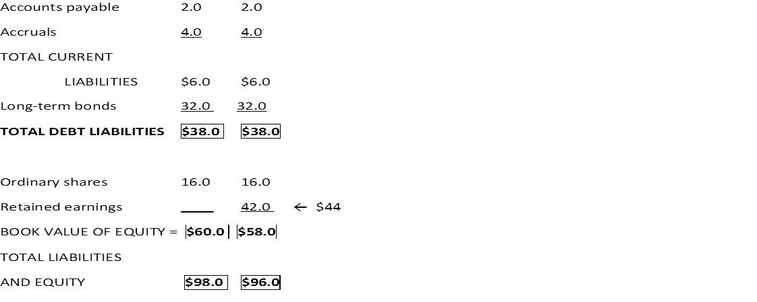
ASSETS LIABILITIES

Slide 16
The Statement of Cash Flows
The Statement of Cash Flows reveals the sources and application of funds by the firm for the financial year.
The statement commences with the funds that have been contributed at the end of the previous year as Net income in the Income Statement, and proceeds to determine how these funds have either been augmented or disbursed by the firm’s activities in the financial year, so as to arrive at the addition (or subtraction) from the firm’s Cash and equivalents – the first entry in the ASSETS side of the Balance Sheet.
We may, alternatively, think of the Statement of Cash Flows as revealing the correct adjustment to the firm’s Cash and equivalents, which is confirmed by observing that the Balance sheet then balances!

Slide 17
The Statement of Cash Flows (cont)
We may note that having determined the firm’s Balance Sheet and Income Statement, NO new numbers enter the Statement of Cash Flows.
In other words, all the numbers in the Statement of Cash Flows are derived from the Balance Sheet and Income Statement.

Slide 18
The Statement of Cash Flows (cont)
As stated, the Statement of Cash Flows commences with the firm’s Net income.
We then proceed to follow the adjustments to this amount in relation to the firm’s:
(1) “Operating activities” (changes to inventory, accounts receivable or accounts payable),
(2) “Financing activities” (dividend payments, new issues of debt or equity),
(3) “Long-term investment activities” (investments not classified as operational “costs”),
so as to arrive ultimately at the final adjustment to Cash and equivalents.

Slide 19
Break time

Slide 20
Ratio Analysis
A ratio analysis allows for the data in the accounting statements to be aggregated in a more orderly manner.
In addition, the ratios facilitate comparisons of the ratios with (i) the firm’s previously recorded ratios, and (ii) the ratios of other firms in the firm’s sector.
Calculation of the ratios follows directly from the definitions.

Slide 21
PROFITABILITY Ratios
Net profit margin = $\frac{Net income}{Sales}$ = 5.5%
Return on Assets (ROA) = $\frac{Net income}{Total assets}$ = 11.0%
Return on Equity (ROE) = $\frac{Net income}{Shareholders^{′}equity}$ = 12.0%

Slide 22
ASSET MANAGEMENT Ratios
Inventory turnover = $\frac{Cost of goods sold}{Inventory}$ = 6.0
Days sales outstanding (DSO) = $\frac{Accounts receivable}{Annual sales/365}$ = 30.0
Fixed assets turnover =$\frac{Sales}{Net fixed assets}$ = 2.2
Total assets turnover = $\frac{Sales}{Total assets}$ = 2.0

Slide 23
LIQUIDITY Ratios
Current liquidity ratio = $\frac{Current assets}{Current liabilities}$ = 4.0
Quick liquidity ratio = $\frac{Current assets− Inventory}{Current liabilities}$ = 2.0

Slide 24
DEBT MANAGEMENT Ratios
Debt ratio = $\frac{Total liabilities}{Total assets}$ = 40%
Times interest earned (TIE) = $\frac{EBIT}{Interest charges}$ = 6.0

Slide 25
MARKET VALUE Ratios
Price/Earnings (P/E) = $\frac{Market price of share}{Earnings per share}$ = 18
Market/Book (M/B) = $\frac{Market price of share}{Book value per share}$ = 2.0

Slide 26
Care in interpreting the ratios
The analyst must have an intimate knowledge of the firm, its sector and the prospects for the sector and the firm in the context of its sector.
It is not always obvious what is an acceptable – or even a preferred - ratio.
For example, too high a Current liquidity ratio or Quick liquidity ratio may be “too much of a good thing”.
In other words, for the “liquidity” ratios, we should be careful before interpreting a higher number for these ratios as “better”. Perhaps the firm is holding too much cash and allowing its debtors too long to pay on their invoices (Accounts receivable) compared with the firm’s own more rapid paying on its invoices (Accounts payable)?
///

Slide 27
Review
The company’s financial statements provide the analyst with data with which to assess the firm’s financial viability.
A good deal of experience and care, however, must be applied in interpreting the accounts.
The examples presented in this chapter are undoubtedly much simplified compared with the complexity of reports for a large company.

